Slide 1

CS 53C Ethical Hacking
Tim Ryan
ryantimothy@fhda.edu

Slide 2
CS53D: Intro to Computer Forensics
Week 1 Agenda
Course Intro and Overview
Textbook, Discussions, NetLab
Incident Response Plans
Data Request Transparency
Linux Command Summary
Lab#4: Forensic Linux Tools
Lab #5: Analyzing Memory
Q & A, Next Steps

Slide 3
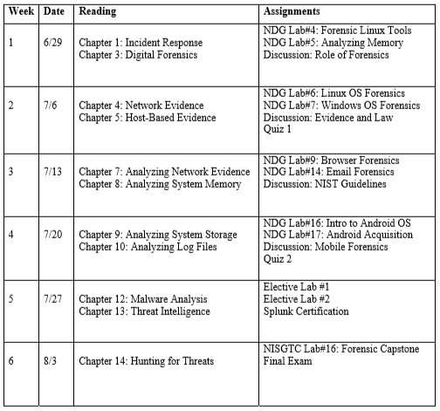
Course Outline - Subject to Minor Changes

Slide 4
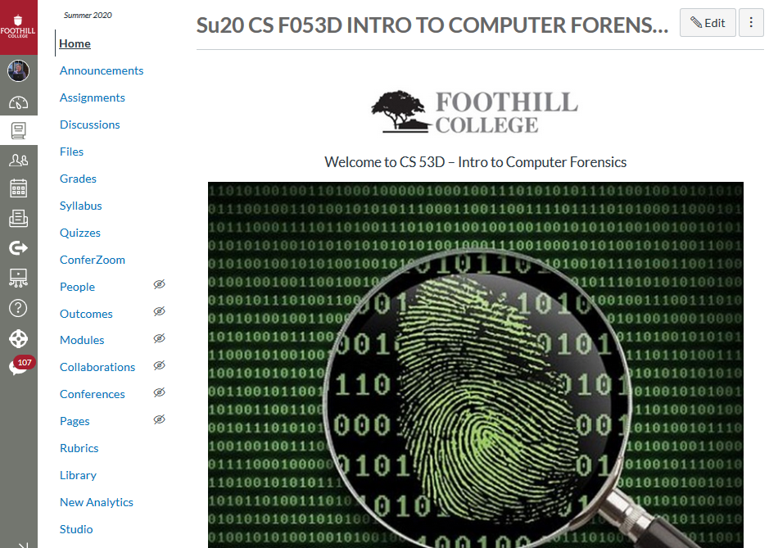
Canvas Learning Management System (LMS)

Slide 5
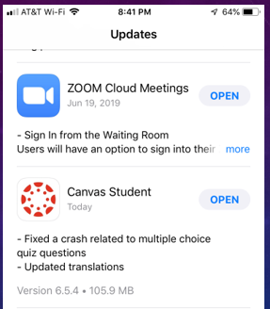
Canvas Mobile App – Keep It Updated

Slide 6
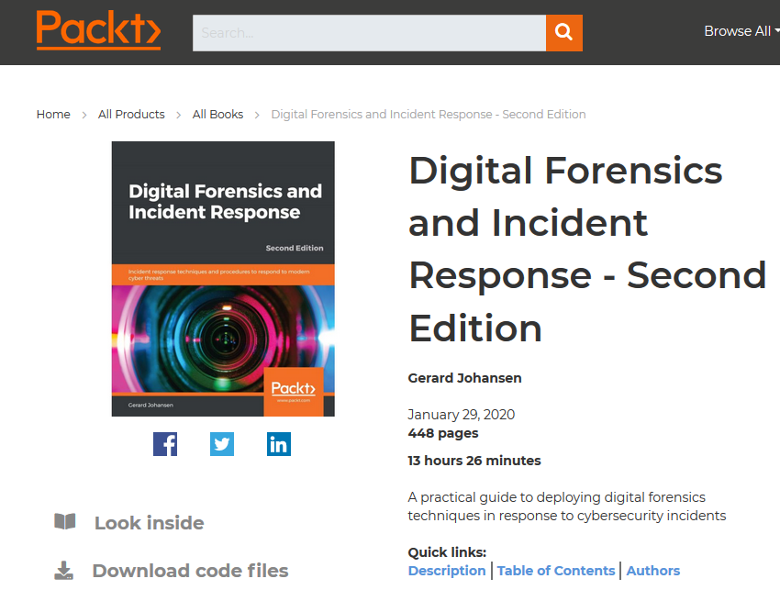
Course Textbook
Source: https://www.packtpub.com/security/digital-forensics-and-incident-response-second-edition

Slide 7
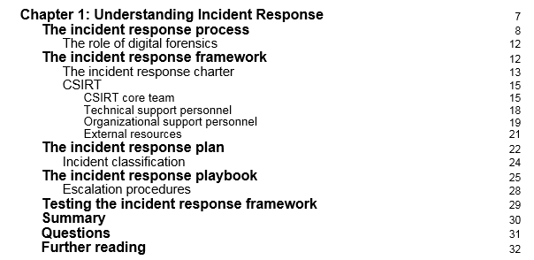
Week 1 Reading Assignment
Ask Yourself – What is an “Incident?”

Slide 8
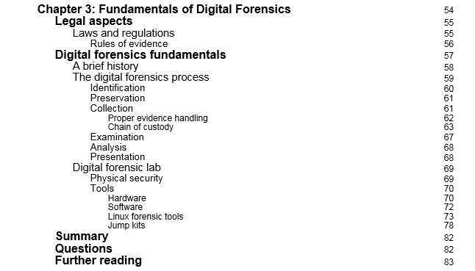
Week 1 Reading Assignment
Ask Yourself – How Often Do Laws Change?

Slide 9
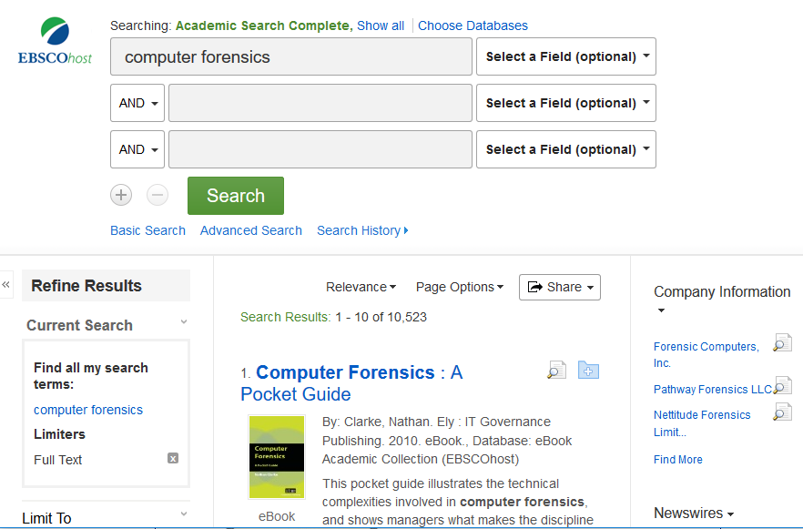
Additional Academic Reading Material
Canvas/Files/Forensics Documents

Slide 10
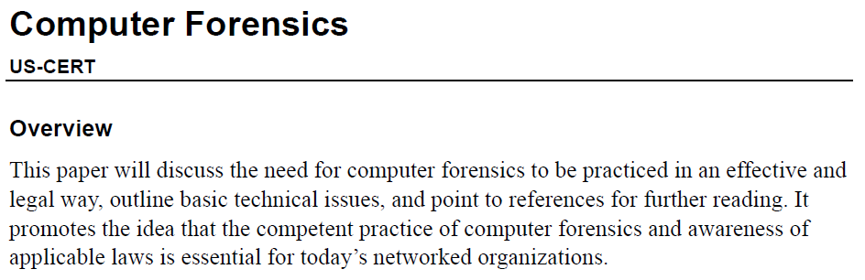
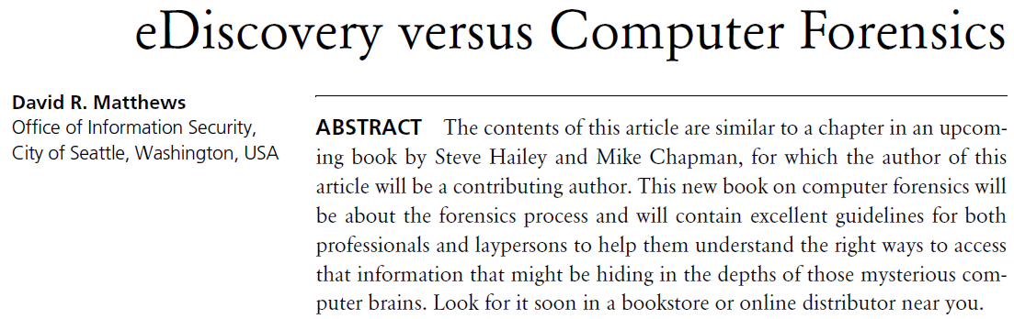

Slide 11
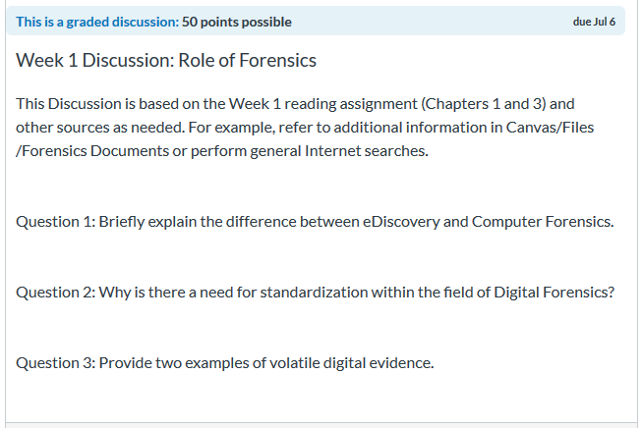
Week 1 Discussion - Graded

Slide 12
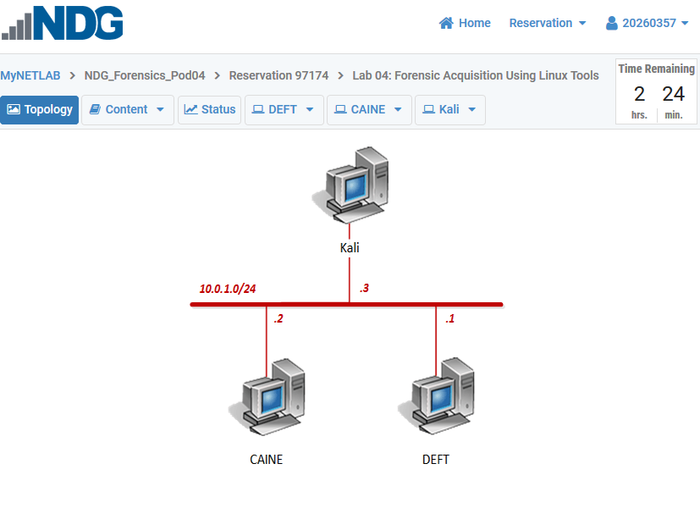
NDG Virtual Lab Environment

Slide 13
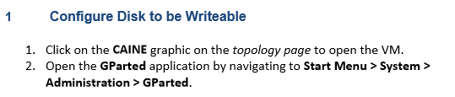
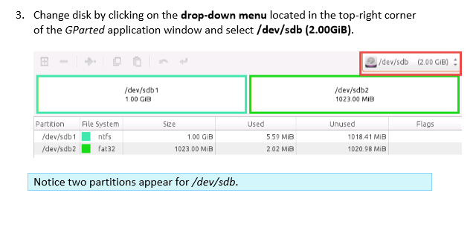
Example – Lab Instructions

Slide 14
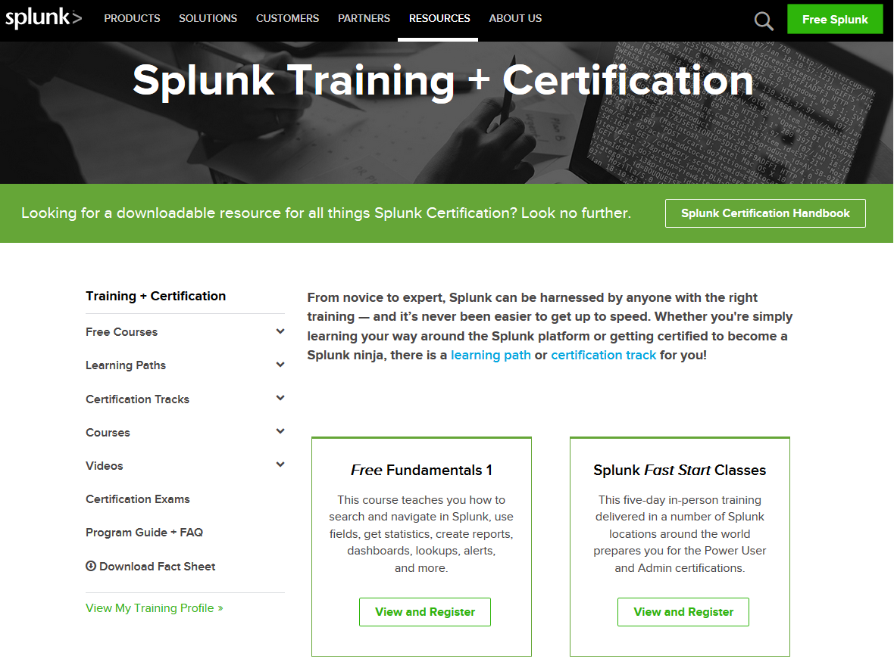
Example – Industry Tools
https://www.splunk.com/en_us/training.html

Slide 15

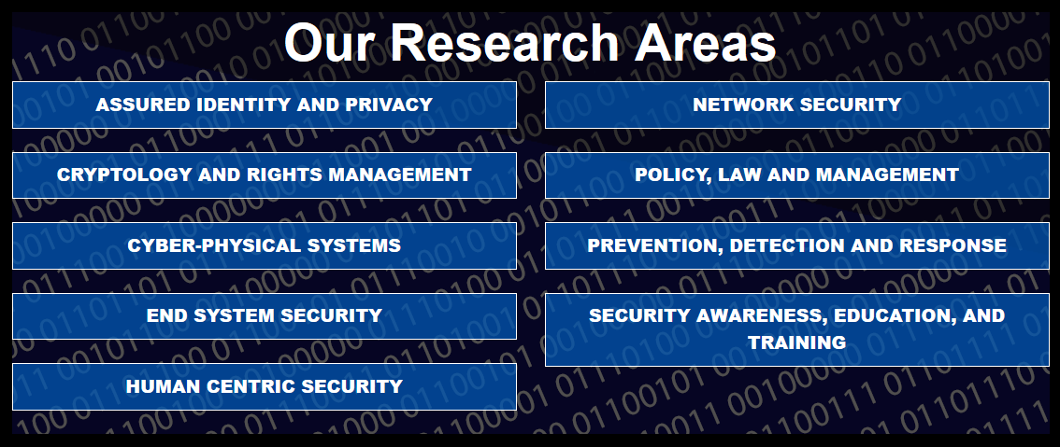
Example – Other Colleges & Universities
https://www.cerias.purdue.edu/

Slide 16
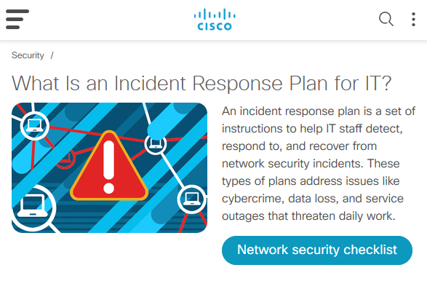
Source: https://www.cisco.com/c/en/us/products/security/incident-response-plan.html

Slide 17
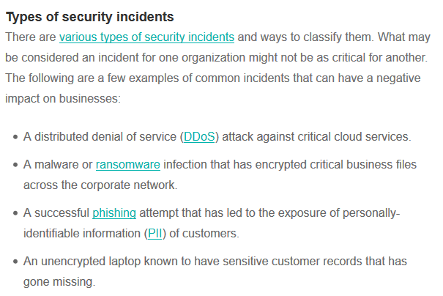
Source: https://searchsecurity.techtarget.com/definition/incident-response

Slide 18
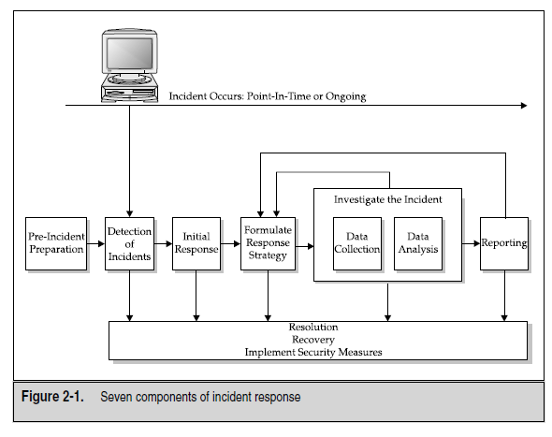

Slide 19
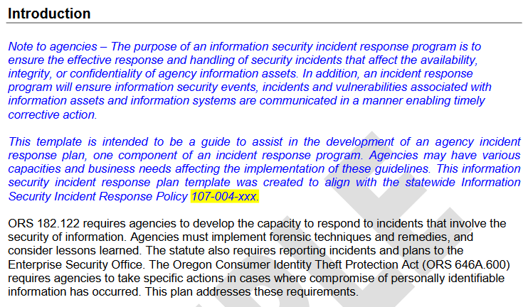
Incident Response Plan Template
Canvas/Files/Course Documents
Source: https://www.oregon.gov/das/OSCIO/Documents/incidentresponseplantemplate.pdf

Slide 20
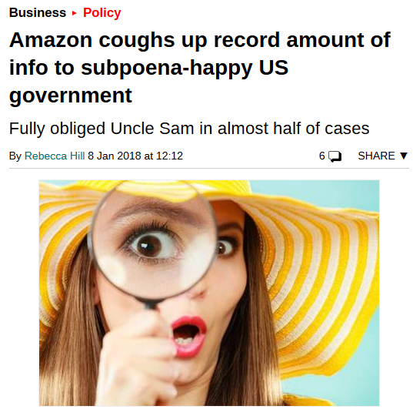
Data Request Transparency
Source: https://www.theregister.co.uk/2018/01/08/subpoenahappy_us_government_sought_record_amount_of_info_from_amazon/

Slide 21
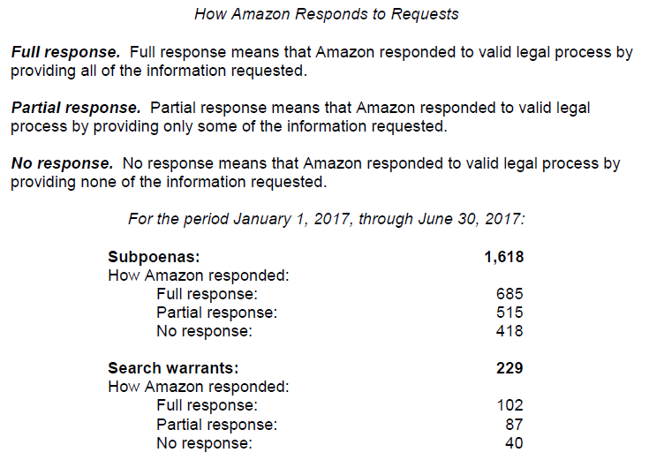
Source: https://d1.awsstatic.com/certifications/Information_Request_Report_June_2017.pdf

Slide 22
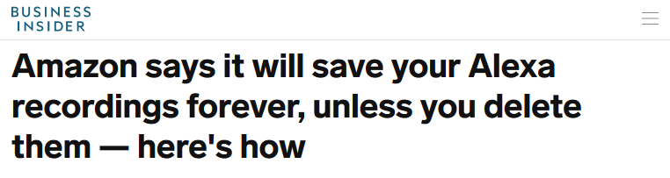
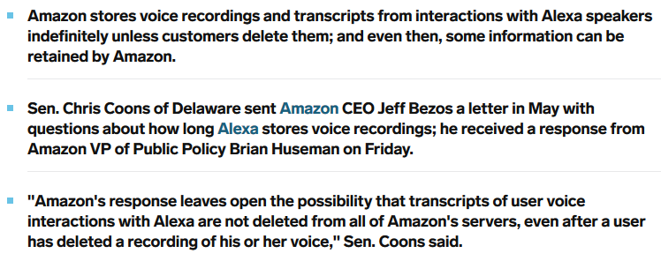
Source: https://www.businessinsider.com/amazon-alexa-delete-recordings-senator-coons-2019-7?utm_source=hearst&utm_medium=referral&utm_content=allverticals

Slide 23
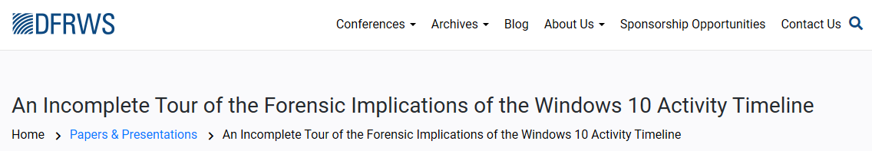
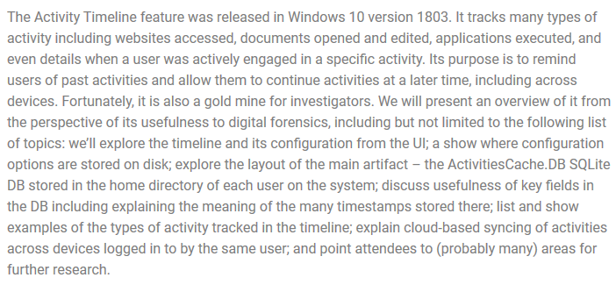
Windows 10 Feature - Is This Good or Bad?
Source: https://dfrws.org/presentation/an-incomplete-tour-of-the-forensic-implications-of-the-windows-10-activity-timeline-2/

Slide 24
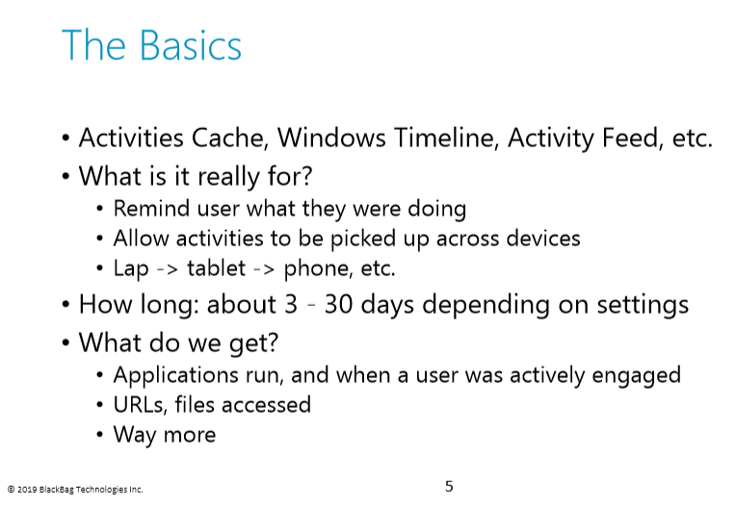

Slide 25

Trust and Transparency
Source: https://www.forbes.com/sites/bernardmarr/2018/11/28/why-trust-and-transparency-will-drive-success-in-our-big-data-and-ai-fuelled-world/#7d527d3b4a3b

Slide 26
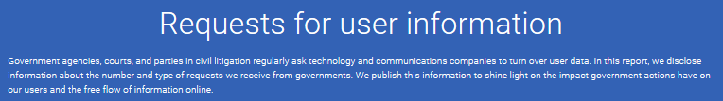
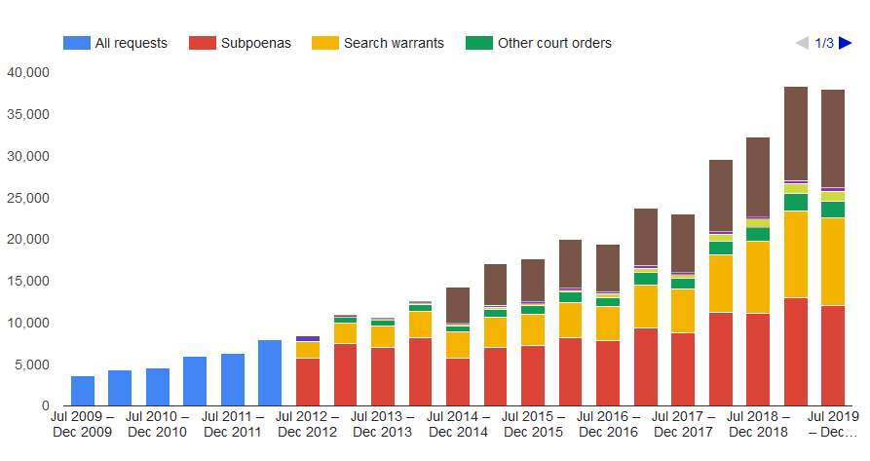
Google Requests – 70,000+ Per Year
Source: https://transparencyreport.google.com/user-data/overview?user_requests_report_period=authority:US

Slide 27
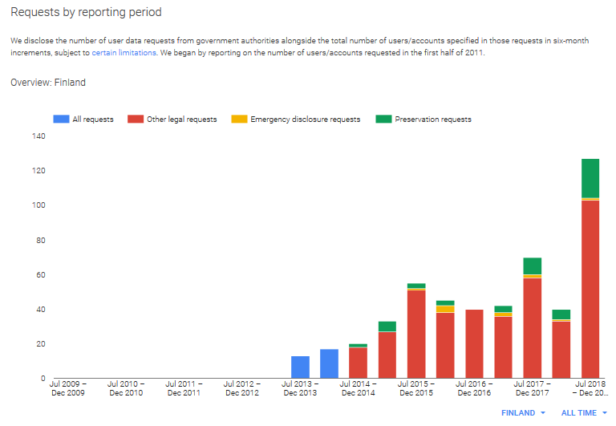
Global Example: Approx. 200 Requests from Finland per Year

Slide 28
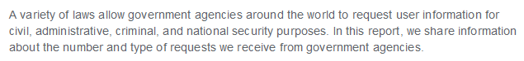
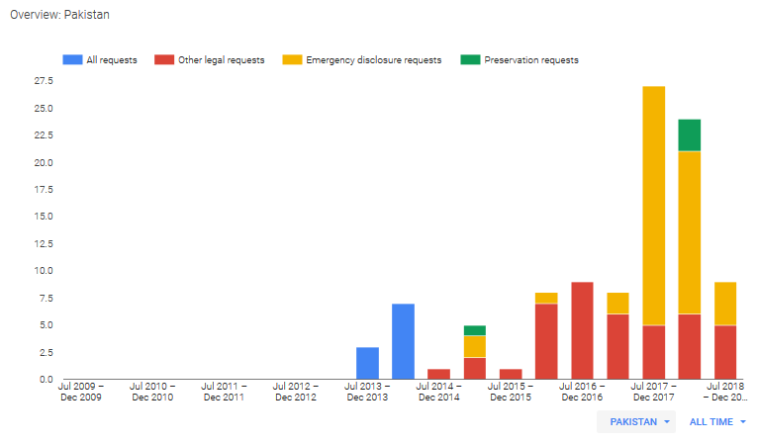
Global Example: Requests from Pakistan

Slide 29
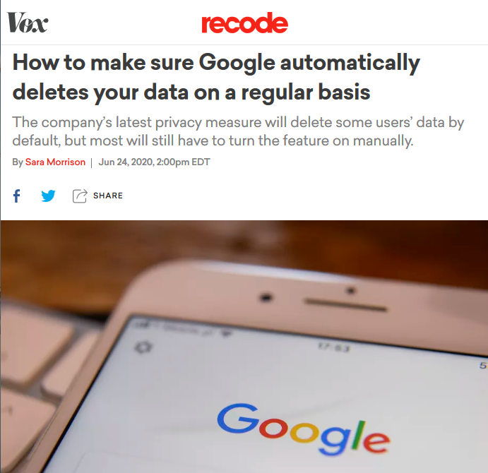
Source: https://www.vox.com/recode/2020/6/24/21301713/google-auto-delete-location-youtube

Slide 30
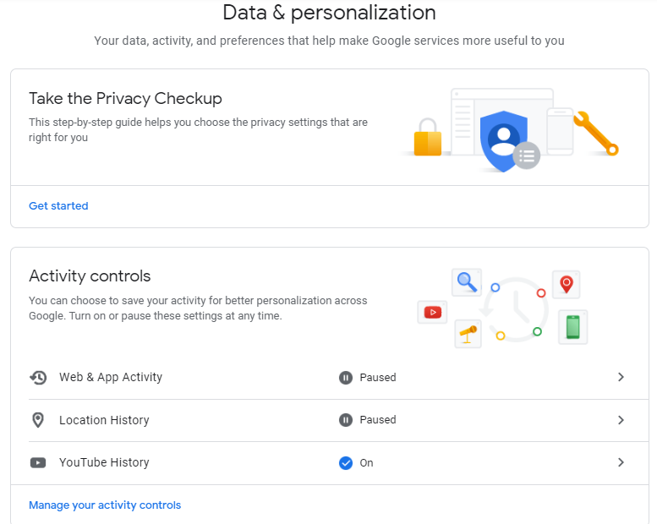

Slide 31
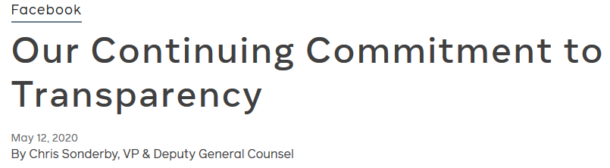
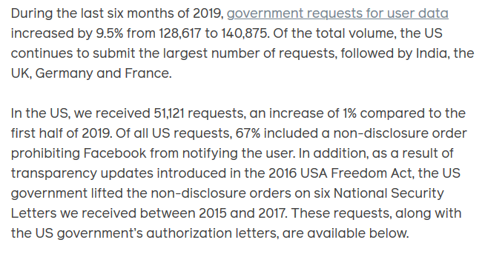
Source: https://about.fb.com/news/2020/05/transparency-report/

Slide 32
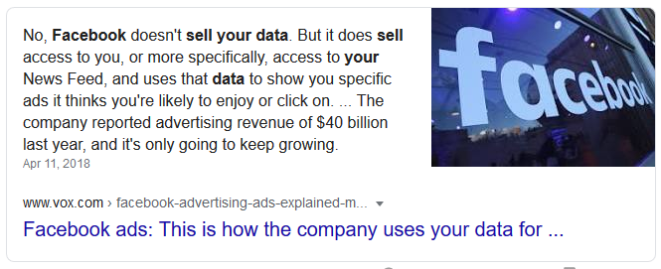
Best Surveillance Tool Ever Invented
Why Share So Much About Yourself?

Slide 33
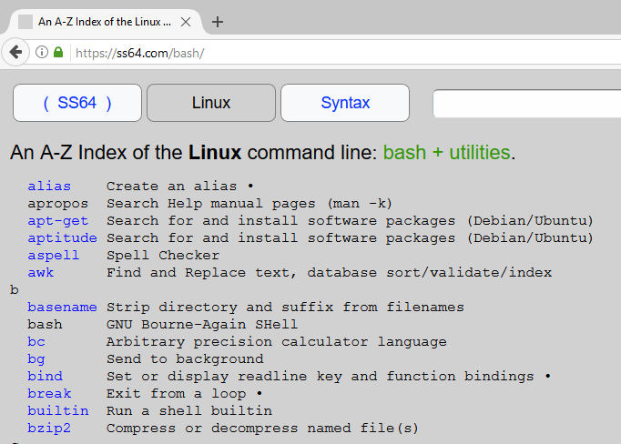
Reference Site for Linux Commands: ss64.com

Slide 34
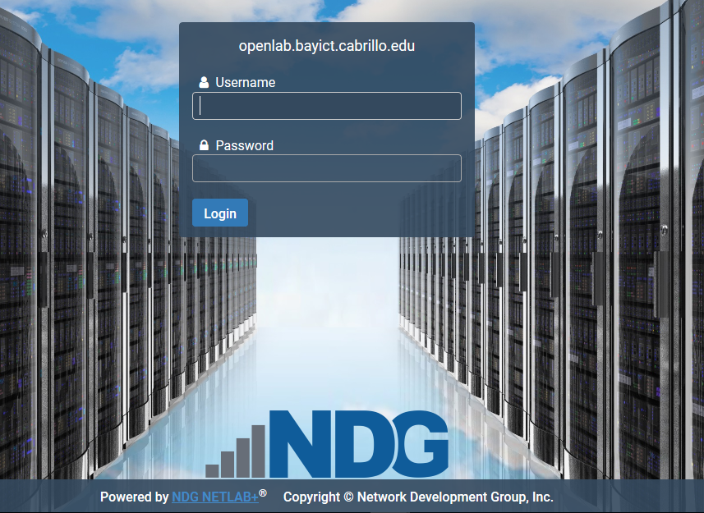
53D NetLab Instructions
Site: https://openlab.bayict.cabrillo.edu
Username = Student ID, Password = currentpassword
New User Temp Password = lovefhda, Change at First Login

Slide 35
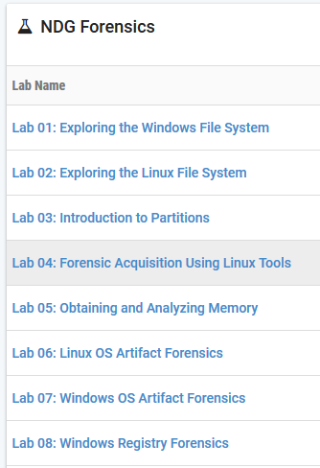
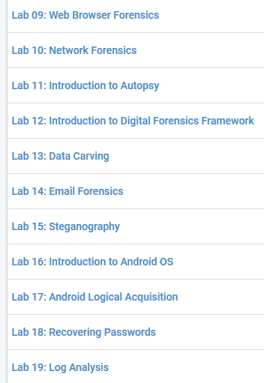

Slide 36
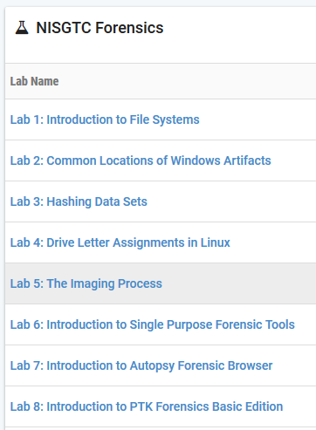
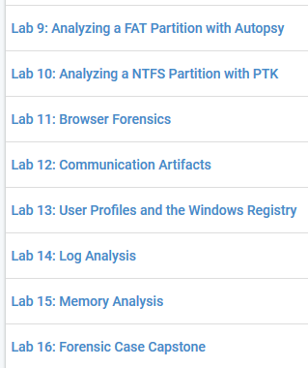

Slide 37
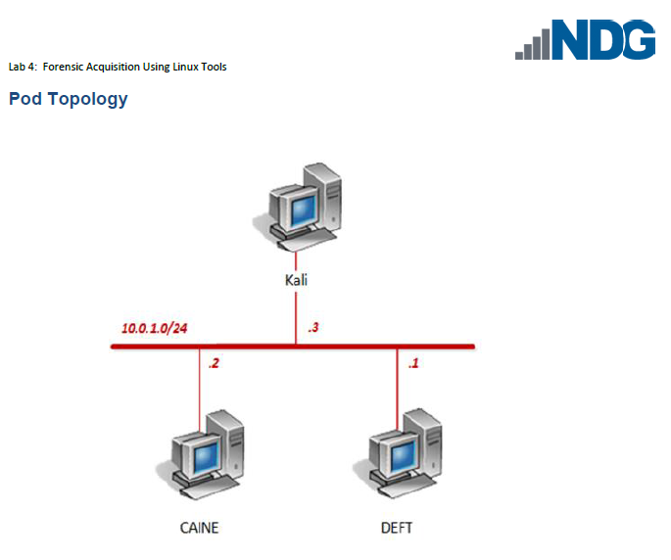
Topology Reference Sites:
https://www.kali.org/
http://www.deftlinux.net/
https://www.caine-live.net/

Slide 38
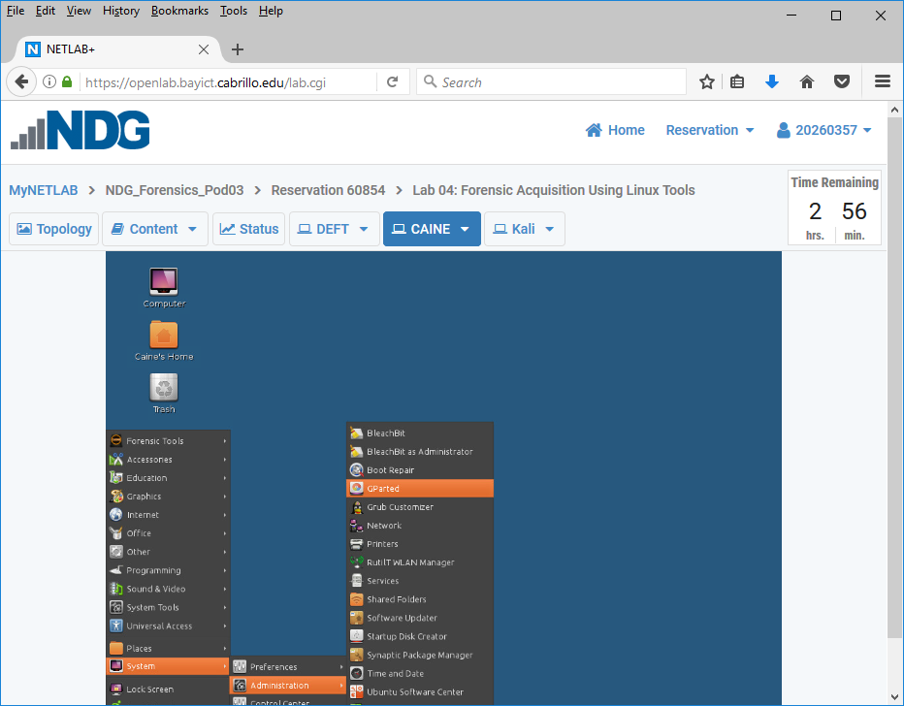
Important: Take 8-10 Screenshots During Lab
Include Login ID (Upper Right) in First Slide
Create ppt, doc or pdf File, Submit in Canvas/Assignments/Lab #4

Slide 39
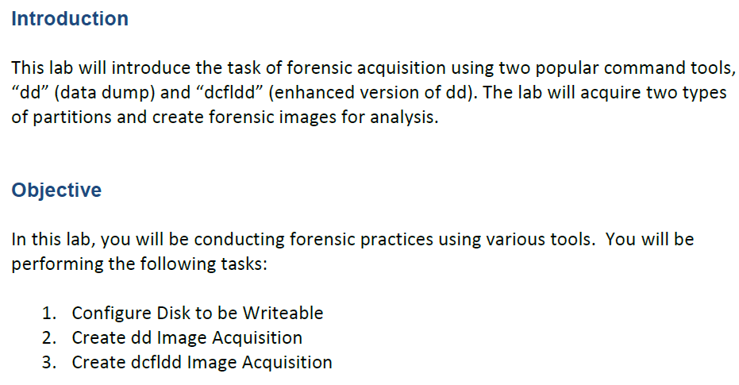

Slide 40
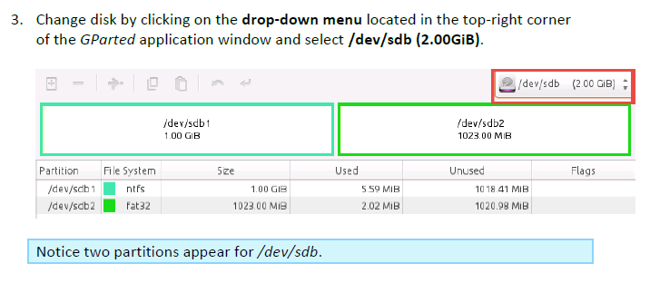
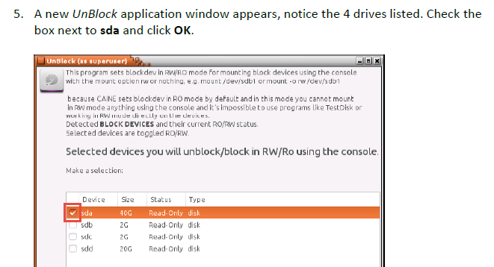

Slide 41
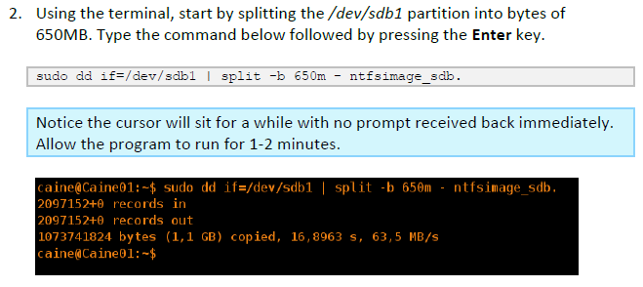
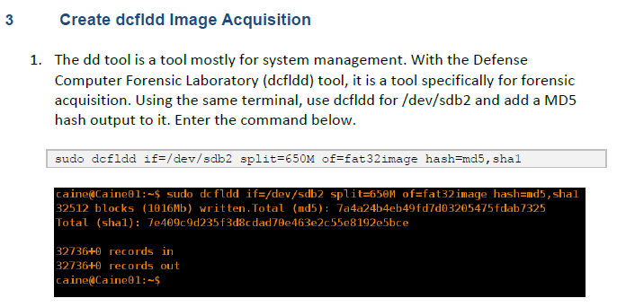

Slide 42
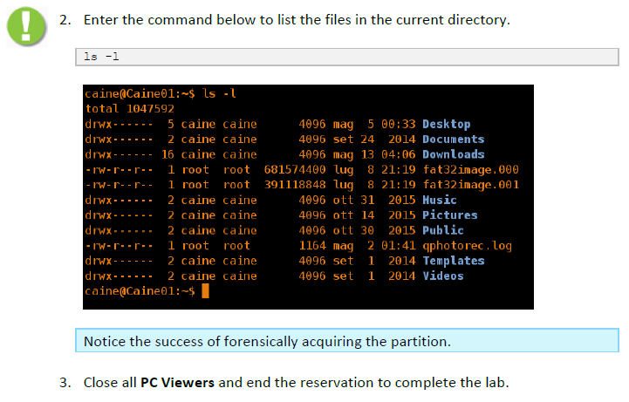

Slide 43


Slide 44


LiME Reference: https://github.com/504ensicslabs/lime

Slide 45



Slide 46


